Slide 1


Airline Reservation System Architecture
A comprehensive relational database design featuring relational constraints, complex entity mappings, and advanced SQL query analysis.

Slide 2
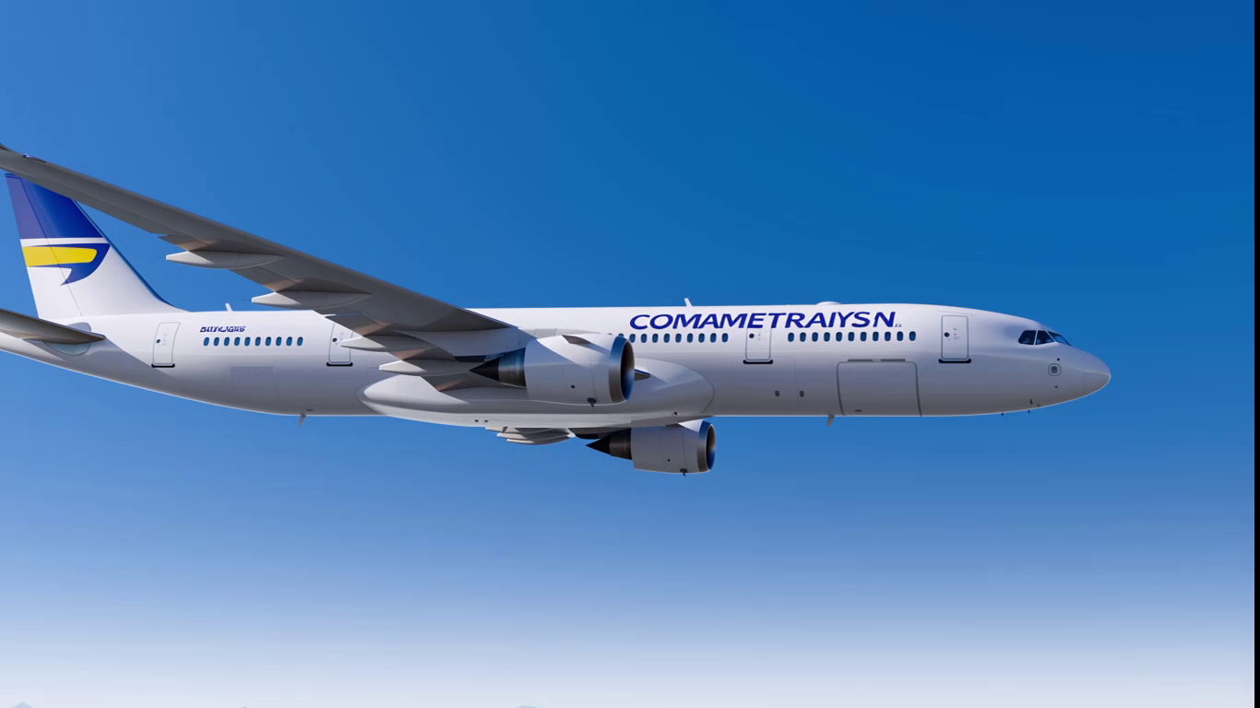


Slide 3

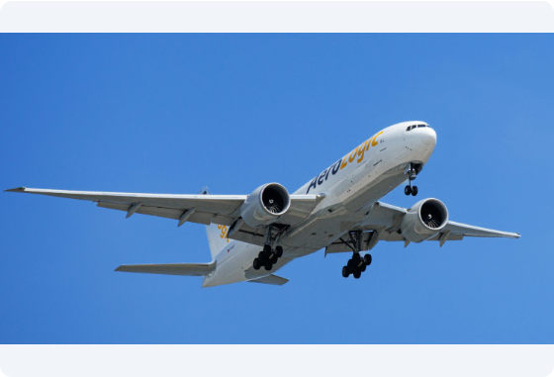
Core System Entities
•
Airline & Aircraft: Manages carrier details and fleet inventory with strictly enforced capacity metrics.
•
Airport & Flight: Tracks global airport hubs along with dual flight route associations (Departure & Arrival).
•
Passenger & Passport: Handles passenger identification tied to single unique passport credentials.
•
Booking Engine: Integrates flight schedules with passenger reservations and transactional booking statuses.

Slide 4






Core System Workflows
Flight Scheduling
Fleet Management
Booking & Ticketing
Dynamic mapping of departure/arrival timestamps, carrier IDs, and aircraft allocation across international airport hubs.
Monitoring seat capacity thresholds per aircraft model to prevent overbooking and optimize payload distribution.
Real-time passenger ticket reservations connecting passenger demographic profiles with specific flight segments.

Slide 5
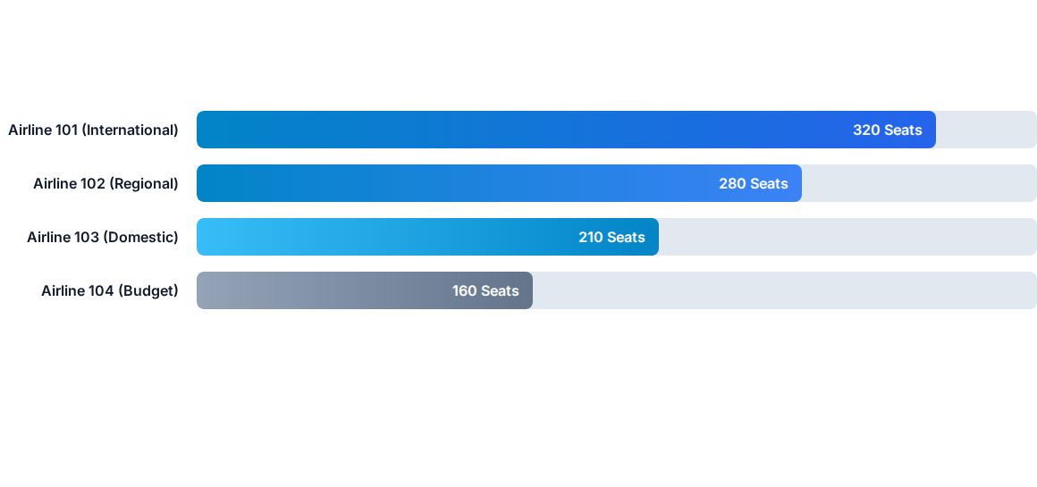
Airline Fleet Capacity Analysis

Slide 6
System Performance & Integrity
100%
Strict Data Normalization
By enforcing FOREIGN KEY constraints across all tables, the database strictly guarantees referential integrity, eliminating orphan booking records or invalid airport references.
Referential Integrity
Auto-incrementing surrogate keys streamline primary indexing and optimize join query execution times.

Slide 7




Database Lifecycle Timeline
Phase 2: Constraints
Phase 4: Schema Alter
Enforcing foreign keys, unique passport rules, and non-null properties.
Updating structure using ALTER TABLE (Adding phone, dropping city).
Phase 1: DDL Design
Phase 3: DQL Analysis
Creating database schema, tables, and auto-increment keys.
Implementing joins, aggregation, and group filtering queries.

